Slide 1
Artificial Intelligence (AI)
October series
Convenors: Shirley Deuchrass
Glynne Lloyd
Allan Panting
? A tiger by the tail

Slide 2
Artificial Intelligence
Artificial Intelligence: Where did this come from?
Allan Panting October 2
Making Sense of AI: What It Means for Our Everyday Lives
Masha McAuley October 9
Social Media, Disinformation, and the Rise of the Alternative Right
Rachel Billington October 16
Demystifying AI: From Sustainable Foundations to Real-World Impact
Madeline Newman October 23
Scams in New Zealand: How to spot them and stay safe
Jessica Walker October 30

Slide 3


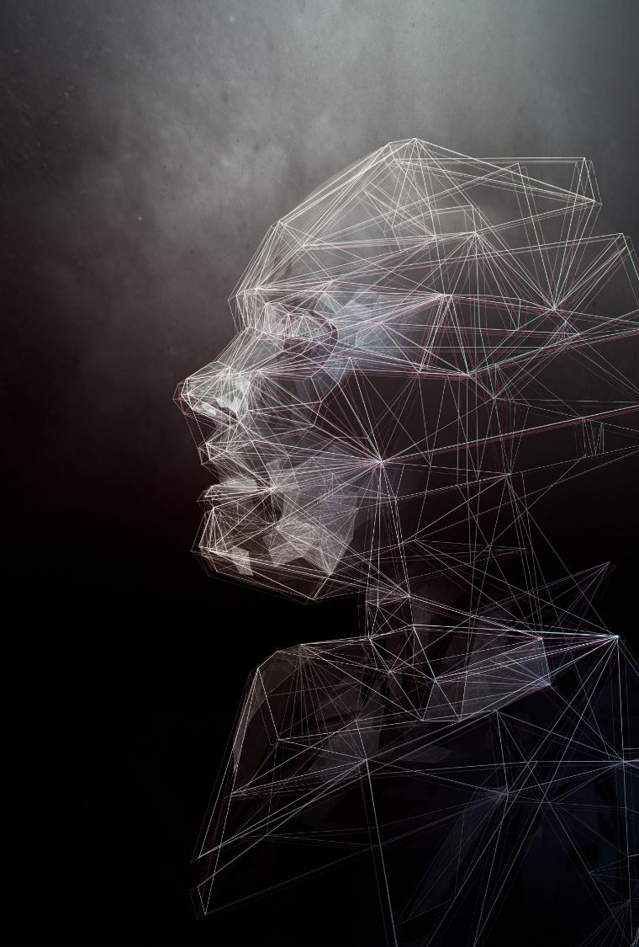
Artificial Intelligence
- Where did this come from ?
Notes:
Apology Shirley Deuchrass, Glynne Lloyd

Slide 4
Disclaimer
I do not claim to be an authority on the development of artificial intelligence.
I have obtained much of the information I will share with
you this morning through the use of –
The Computer
The World Wide Web
The Internet
Wikipedia
&, of course, Artificial Intelligence
Notes:
Most scientific presentations are introduced with a slide declaring any conflict of interest

Slide 5
Key Events
1100 bce - Simple counting and calculation –
1600 AD the Abacus, the Logarithm
1600 -1830 Calculating machines – Babbage
1820 -1830 Machine instruction – Jacquard Loom
Programming - Ada Lovelace
1800 -1950 Business Calculators
1930 -1950 Early computers – calculating machines with greater capacity
WW2 stimulus - Alan Turing
1937 -1950 Decimal data finally yields to Binary
Notes:
Brief look at the major developments.
Each contributed to the development of Artificial intelligence

Slide 6
Key Events continued
1935 - Programming – new languages
1959 - The microchip
1975 - Software
Hardware – the Workstation & the PC
1995 - The Internet
Handheld devices
1800 - Artificial Intelligence

Slide 7
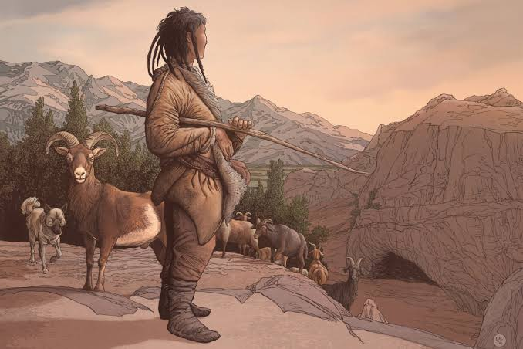
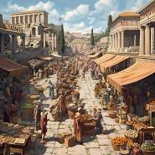
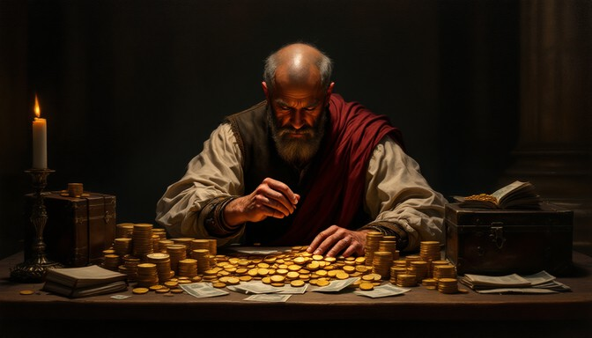
Simple Counting and Calculation
Notes:
Need to count – animals
goods bartered or sold
Money
Just simple addition & subtraction

Slide 8
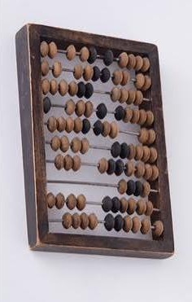
The Abacus
Digital values represented – numbers, length, weight
Each bead in one of two defined positions
= binary choice
Binary choice - 0 or 1
Notes:
The abacus is earliest known device for mathematical calculations
Basic counting device for at least 2,500 yrs

Slide 9
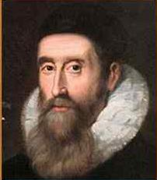
Logarithms
John Napier 1550-1617
1614 - The log of the sum of two
numbers added together = the sum
of the logs of the separate numbers
eg log ₂ (8) = 3
+ log ₂ (16) = 4 is the same as
log ₂ (128) = 7
This conversion of multiplication into addition greatly
simplified the possibility of mechanisation.
Notes:
John Napier, 8th Laird of Merchiston – Scottish mathematician, physicist & astronomer published his discovery of logarithms 1614,
Adding any two numbers easier than multiplying

Slide 10
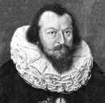
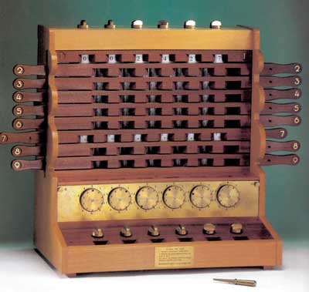
The First Calculators
1632 - Wilheim Schickard built a device able to
add and subtract 6-digit numbers
Notes:
At same time first calculators being developed
German astronomer & mathematician – Wilheim Schickard
Could add & subtract six digit numbers
Leonard da Vinci – 100 years earlier

Slide 11
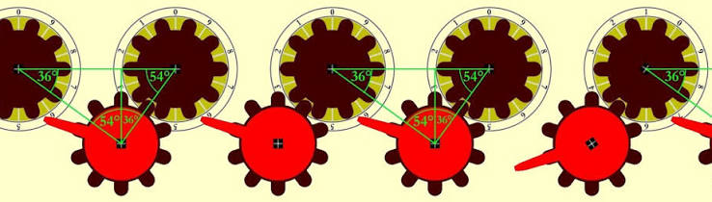
10 toothed gear ring
Single tooth ring attached to 10-tooth gear ring
Notes:
Consisted 6 interlocking gears - one full revolution activated one tenth of a revolution of the adjacent gear
– decimal based

Slide 12
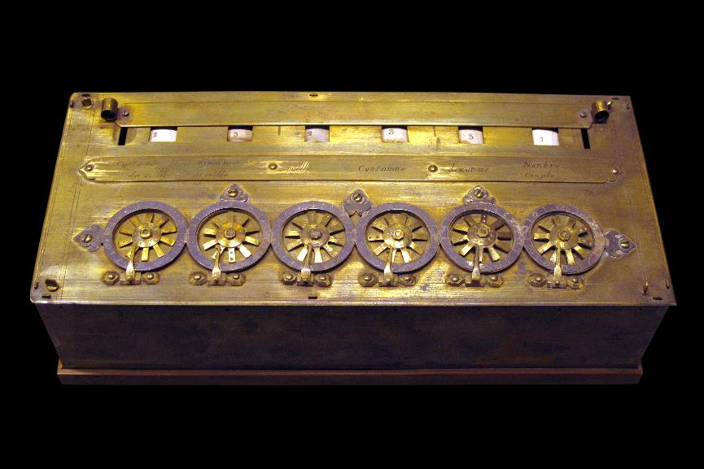
Pascaline/Arithmetic Machine
Blaise Pascal built the Pascaline/Arithmetic machine 1642-44
50 built during next 10 years
Notes:
Blaise Pascal (1623 – 1662) a French child prodigy - mathematician, physicist & philosopher
At age 19 years produced the Pascaline/ Arithmetic machine
Invented for father – a tax collector
Only able to complete addition & subtraction

Slide 13
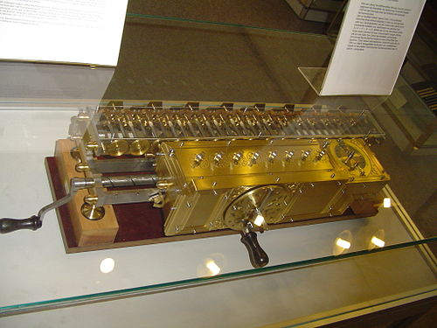
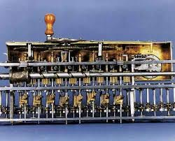
Step Reckoner
1671 German mathematician-philosopher Gottfried
Wilhelm von Leibniz designed a calculating machine
able to multiply by repeated addition and shifting
Notes:
Less than 30 years later a machine capable of multiplication had been designed

Slide 14
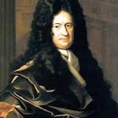
“... it is beneath the dignity of excellent men to waste their time in calculation when any peasant could do the work just as accurately with the aid of a machine. “
Gottfried von Leibniz
(1646 – 1716)
Notes:
Leibniz summarised our approach to this work in the quotation attributed to him

Slide 15
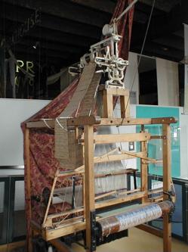
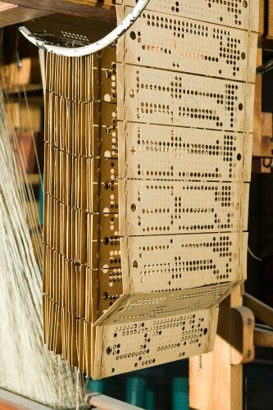
Industrial Revolution need to perform
repetitive operations efficiently.
Machine Instruction
Early automation – Punch cards
Jacquard loom invented
1804–05 by French weaver, Joseph-Marie Jacquard
(1753 – 1834)
Notes:
Textile weaving loom – pattern produced was dependent upon arrangement of rods controlling colours and the movement of the shuttle between them.
Punch cards could be created to manage the order in which the rods were arranged before each passage of the shuttle – with a reading device a significant degree of automation was achieved.
Complex weaving patterns became readily reproducible.

Slide 16
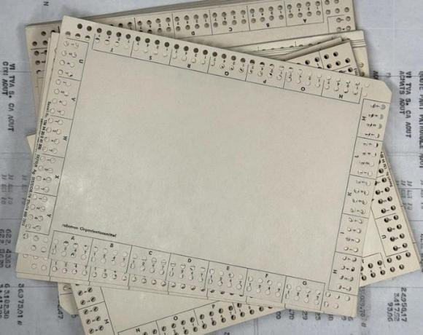
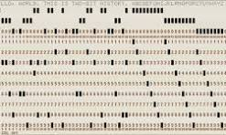
Punch cards
Simple card
Extended roll
Notes:
The punch card was available as separate cards or as part of a roll

Slide 17
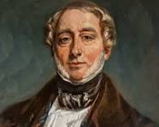
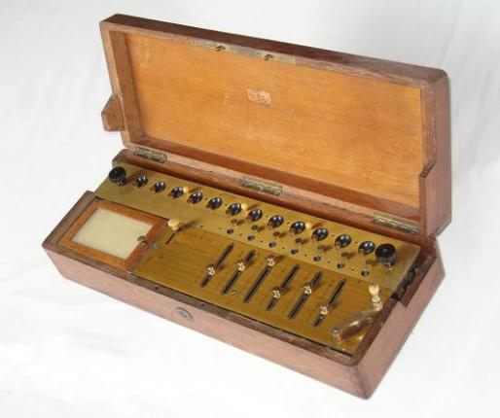
Calculating machines – further development
Charles de Colmar (1785 -1870)
in 1820 built the Arithmometer
based on Leibniz’s work.
Able to add, subtract, multiply
& ”divide”
Notes:
There was little further development of calculating machines during the next 150 years until 1820.
De Colmar spent 10 years in the French army becoming Inspector for supply of the entire army – recognised the need for better means of accounting.
The Arithmometer however represented a significant advance - covered a desktop, 5,500 built 1850 - 1915

Slide 18
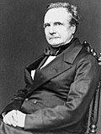
The Babbage Difference Engine (1820s)
Charles Babbage (1791- 1871), a
polymath, mechanical engineer & astronomer. Presented paper (1824)
“On the Theoretical Principles of the
Machinery for Calculating Tables”
Based upon pre-existing decimal
calculating machines but designed to calculate to 20-30 digits
Never built but Analytical Engine
Notes:
Simultaneously in England Charles Babbage was designing a much more elaborate machine
Mathematician & member of Royal Astronomical Society
Tables available contained errors – automation would overcome.
British Govt support to build 1,700 pounds in1823 – 17,000 pounds 1842. ($5.7m NZ 2026)
Joseph Clement – precision engineer

Slide 19
Babbage Analytical Engine
General purpose, programme–controlled, automatic mechanical computing machine
Described four components –
the Mill = Central Processing Unit (CPU)
the Store = Memory / storage
the Reader = Input device
the Printer = Output device
Not built but all the features of a computer described
Notes:
While struggling to have Difference Engine built, Babbage conceived Analytical Engine.
Carefully designed & accurately described – Royal Astronomical Society

Slide 20
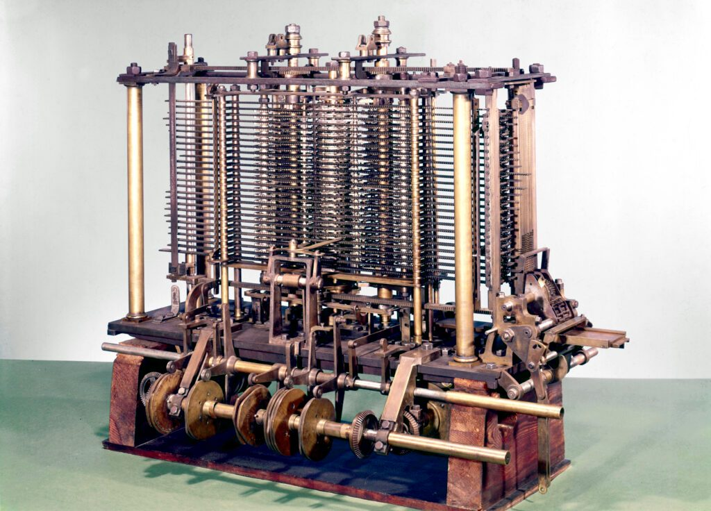
Analytical Engine created from Babbage’s plans

Slide 21
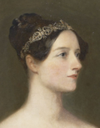
The First Computer Programmer
Ada Lovelace (1815 -1852)
Gifted mathematician – noted
* Analytical Engine operated on
general symbols rather than
numbers
* It went beyond the bounds of arithmetic.
Lovelace became expert on the process of sequencing instructions on the punched cards that the Analytical
Engine would use - The first computer programmer
*
Notes:
Daughter of Lord Byron & a gifted mathematician.
Lovelace attended Babbage’s lectures & fascinated by his proposal
Made important observation – machine could operate on symbols

Slide 22
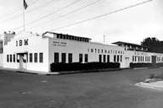
Business calculators
Through the 19th century business calculators became a necessary tool – the catalyst for development
Remained the dominant instrument until 1970s
Notes:
As calculators became essential to business this spurred the technology to create a computer.
Merging of several calculator manufacturers at the end of the 19th century resulted in the formation of the International Business Machines Corporation (IBM)
IBM would play a major role in the development of the computer

Slide 23
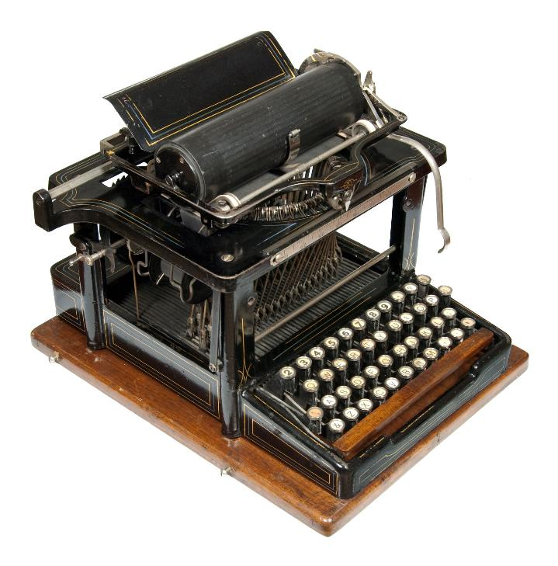
The Keyboard
In 1874 the Remington Arms Company, sold the first commercially viable typewriter
* Became a key data input device
Notes:
Concurrent with the development of the business calculator was the creation of the typewriter with its keyboard.
During the early 20th century the importance of the calculator had been significantly extended as more complex mathematic solutions were incorporated.
Consequently, by 1930 (less than 100 years ago) the scene was set for the development of the computer as we know it.

Slide 24
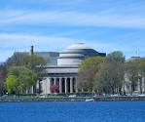
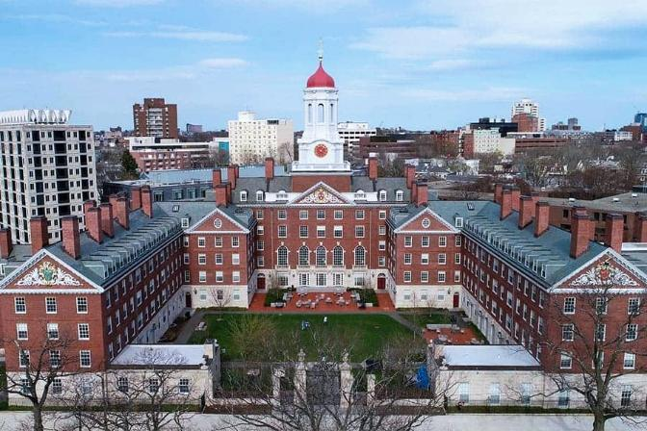
Early computers
At Massachusetts Institute of Technology
Vannevar Bush designed the Differential
Analyser – able to solve certain differential
equations
At Harvard University Howard Aitken
explored alternatives to electromagnetic
relay circuits then in use in business
digital calculators
Notes:
During the 1930s 2 universities in Cambridge USA provided theoretical impetus to the development of the computer.

Slide 25
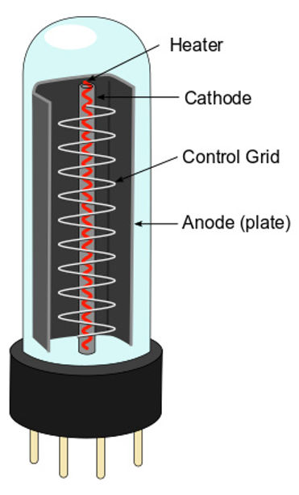
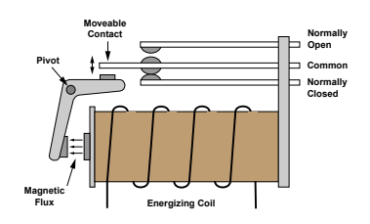
Advances in technology
Electromagnetic relay switch
Vacuum tube
Notes:
The electromagnetic relay switch is a simple on/off switch with contacts activated by an electric current acting through an electromagnet.
The device originally developed to relay the dots and dashes of the Morse telegraph over long distances.
The vacuum tube was able to amplify weak electrical signals and switch currents much more rapidly than the electromagnetic switch & was more reliable.
Through their on/off functioning they introduced binary selection into calculator functioning

Slide 26
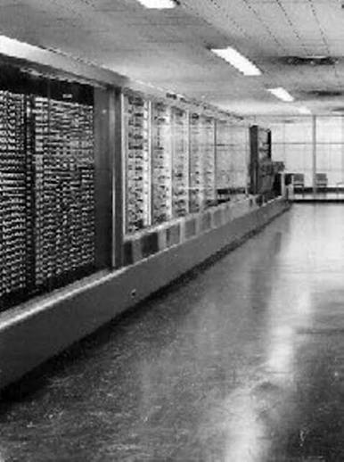
1st computer 1939-44
Aitken in collaboration with
IBM planned & built fully
functional computer
(calculating machine).
Notes:
More than 15 metres long, it weighed 4,500 kg (5 tons) and consisted of about 750,000 separate parts.
Input and output required three paper-tape readers, two card readers, a card punch, and two typewriters and it took between three and six seconds to add two numbers.

Slide 27
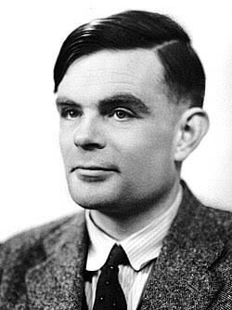
Alan Turing (1912 -1954)
Mathematics student at the
University of Cambridge,
England
Theory - “any mathematical
problem can potentially be
solved by an algorithm – a
purely mechanical process.”
Notes:
Turing would come to have a major influence on the development of the computer and was the first to indicate the possibility of artificial intelligence.
Turing set out to design a computing machine capable of resolving all mathematical problems.
He proved it impossible to create a universal mechanical mathematical solver.

Slide 28
Alan Turing Contd
Turing defined the basic
concepts of a universal
computing machine
He believed everything – letters,
values, abstract mental states
could be represented
symbolically.
Artificial Intelligence.

Slide 29
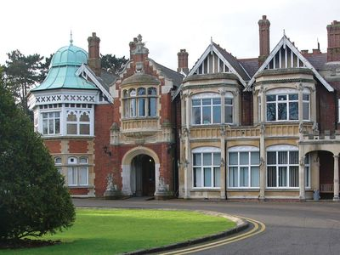
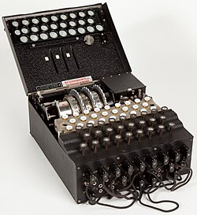
WW2 stimulus
In Britain the impetus was code breaking.
The Ultra project at Bletchley Park, London targeted the ciphers & codes of the German electromechanical devices - the Enigma and the Geheimschreiber (“Secret Writer”).

Slide 30
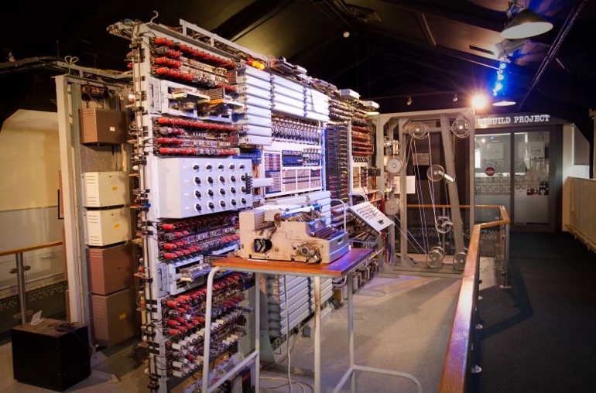
WW2 stimulus
Turing’s advocacy helped
maintain government
support but pushed the
project further towards a
general-purpose device
Colossus (Mark 1) completed
in December 1943

Slide 31
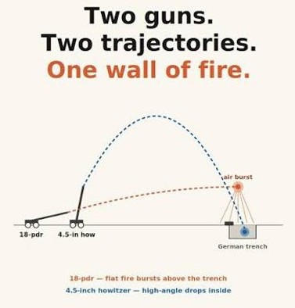
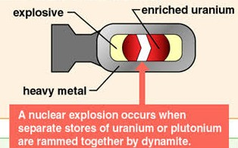
WW2 stimulus
In the US, the stimulus was
artillery projectile trajectories
&
assisting design of an
atomic bomb

Slide 32
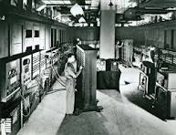
WW2 stimulus
In 1943 in the US, an all-
electronic computer, the
ENIAC (Electronic
Numerical Integrator &
Computer) was developed
* 18,000 vs 1,500 vacuum tubes
* 1000 x faster than Mark I
Notes:
ENIAC enormous..
Vacuum tubes had a significant failure rate – with large numbers rate of burn out = replacement rate

Slide 33
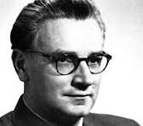
Decimal data Binary data
Konrad Zuse – Germany 1937
Binary logic to simplify construction
Developed instruction language
Z3 completed 1941 – the worlds
first programmable computer
Notes:
Konrad Ernst Otto Zuse was a German civil engineer, pioneering computer scientist, inventor and businessman.
His greatest achievement was the world's first programmable computer; the functional program-controlled computer.
Complete Z3 became operational in May 1941.

Slide 34
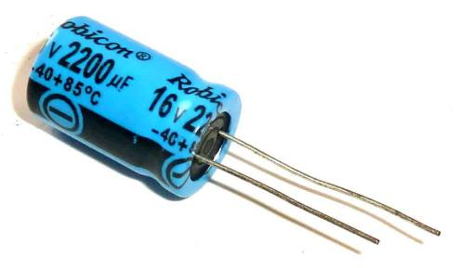
Binary data computing
John Atanasoff & Clifford Berry 1939
- electronic computer prototype
  capacitors to store data in binary
  form &
  electronic logic circuits to perform
  addition and subtraction.
  300 vacuum tubes controlling calculations, binary numbers,
  had memory capacitors & used logic operations
Variations of Atanasoff-Berry Computer
(ABC) built 1939-42
Notes:
John Atanasoff, a physicist and mathematician at Iowa State College & graduate assistant Clifford Berry,
Capacitor works like a tiny rechargeable battery with very low capacity. It has two plates separated by an insulator.
When a voltage applied, one plate develops a positive charge, the other a negative charge. The charge is stored & can be released in a fraction of a second when needed. Used for adding a time delay, creating oscillators, & as tiny backup generators for microcontroller.
Computer featured - 300 vacuum tubes to control calculations, binary numbers, logic operations (instead of counting), memory capacitors

Slide 35

Computer language
1946 - working group – John von Neumann,
Princeton University “Preliminary
Discussion of the Logical Design of an
Electronic Digital Computing Instrument”
  Instructions coded & modifiable by subsequent instructions
  A single store for data & instructions – would permit rapid access but required increased memory storage
This required computer language
Notes:
John von Neumann, Hungarian & American mathematician, physicist, computer scientist & engineer with extensive contributions to many fields, including mathematics, physics, economics. He played a major role integrating pure & applied sciences, was a pioneer in building the mathematical framework of quantum physics, in the development of functional analysis, & game theory.

Slide 36
High-Level language (HLLs)
Compilation – where language (instruction) converted to machine language and stored for subsequent access
Fortran (FORmula TRANslation) 1954 – looking rather like mathematics
DO 10 J = 1,11
I = 11 − J
Y = F(A(I + 1))
IF (400 − Y) 4,8,8
4 PRINT 5,1
5 FORMAT (I10, 10H TOO LARGE)
Notes:
One implication of the stored-programme model was that any subsequent programme could read & operate on the programme data & would be capable of self-modification.

Slide 37
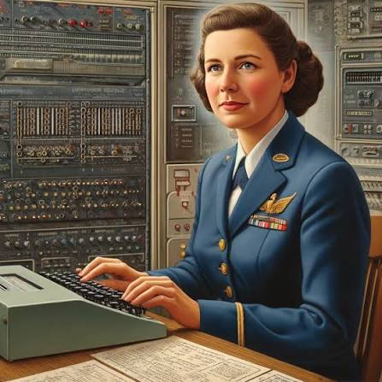
HLL
Grace Hopper (1906 – 1992)
“Queen of Computer Code”
– COBOL (Common Business Oriented
Language) - 1959
English–like syntax and vocabulary
1 COMPARE PART-NUMBER (A) TO PART-NUMBER (B);
IF GREATER GO TO OPERATION 13;
IF EQUAL GO TO OPERATION 4;
OTHERWISE GO TO OPERATION 2.
Notes:
Grace Hopper, mathematician & computer scientist directly involved in computer programming. Hopper applied to be commissioned in the Navy early in WW2, however she was turned down - age 34, she was too old to enlist and her weight-to-height ratio was too low, but later accepted & at retirement age 79 years was Rear-Admiral in US navy.
She campaigned for high-level languages across the US, led a group which progressively developed COBOL (Common Business-Oriented Language) based upon more English-like syntax and vocabulary:
COBOL was explicitly a business programming language which became central to the wide acceptance of computers by business after 1959. FORTRAN, better suited for mathematicians and engineers continued to evolve, and retains a large user base in academia and among scientists.

Slide 38
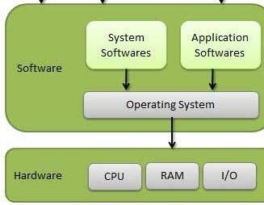
Control programmes – operating systems (O/S)
1954 - IBM had developed a
stored O/S - specific to form of
computer use
Run in parallel with application
programmes, able to be paused
& restarted without loss
1960s - IBM develops a universal
O/S
Notes:
Operating system (O/S) – computer control function handling the behind-the-scenes such as managing the transitions from one programme to another and access to disk storage and peripheral devices.
Needed to run in parallel with any application programme in use & able to be paused and restarted at same point where interrupted
1960s – separate lines for accounting, commercial data-processing, scientific-technical, decimal etc

Slide 39
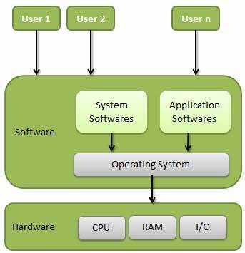
Interactive computing
Concept of interactive (time-
sharing) computing (1959)
Required new language
BASIC (Beginner’s All-
Purpose Symbolic Instruction
Code)
Notes:
Batch processing - user handed a deck of punched cards to an operator, who fed them to the machine, & an hour or more later the printed output would be made available for pickup.
Interactive computing involved typing on a keyboard and obtaining immediate feedback from the computer.
Fortan and Cobol sidelined

Slide 40
UNIX
Time-sharing resulted in the need for an alternative O/S
* Concept of ‘pipes’ to allow user to feed results of one programme to another to use as input
* Multi-tasking network security
UNIX resulted

Slide 41
UNIX
Bell Labs made UNIX source code freely available to
colleges & universities numerous O/S
UNIX the basis for the development of a variety of O/S
– Microsoft MS-DOS, Apple-Mac 2001, Chrome (via
Google), Ubuntu
1991 Linus Torvalds Linux O/S – an open-source
software based upon UNIX.
UNIX still most common O/S in academic institutions and
WWW servers.

Slide 42
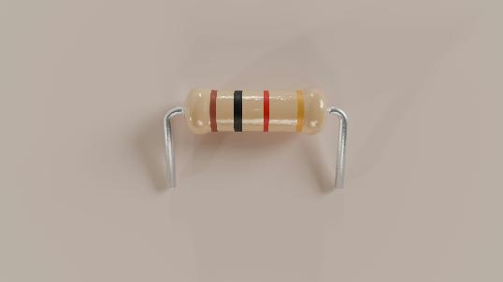
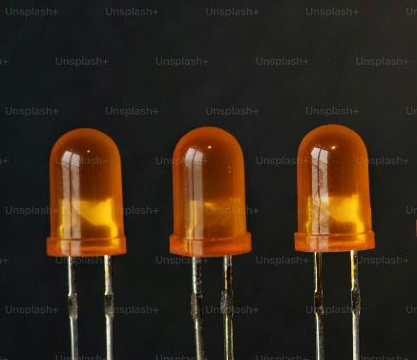
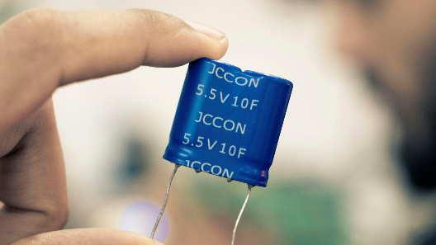
Advances in Technology
Transistor 1947 – a simple
on/off device providing pulses
of energy
Replaced the vacuum tube &
electromechanical switches
Binary digital code
Each pulse = 1 bit
8 bits = 1 byte

Slide 43
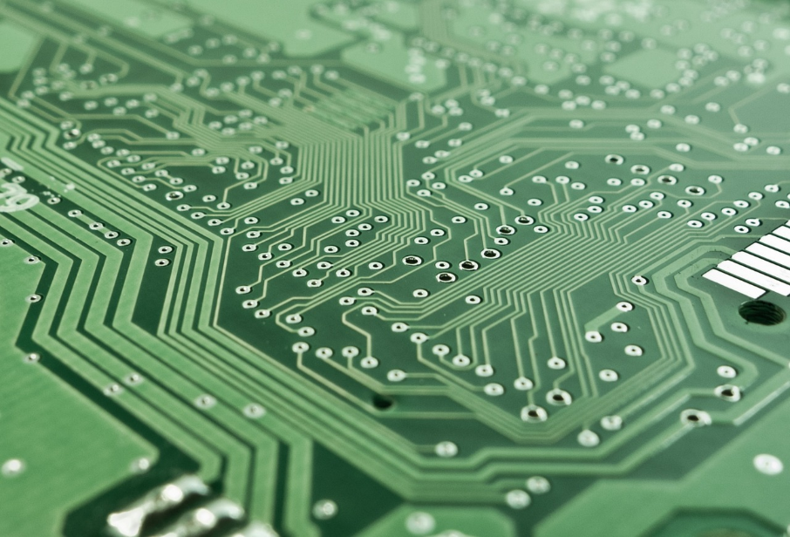
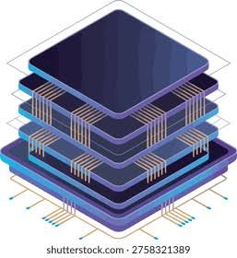
The Microchip
Development of the integrated circuit of millions of interconnected transistors & resistors linked by fine copper wire & embedded in a silicon wafer.
Notes:
The integrated circuit (a set of interconnected transistors and resistors on a single silicon wafer, or chip) enabled the development of the first true mass-market minicomputer.
A microchip is structured like a nanoscopic 3D city, with billions of transistors (switches) built in layers and connected by miles of microscopic copper wires.
In 1959 the silicon monolithic integrated circuit using the planar process was developed making mass production commercially viable.
From the mid-1960s into the early ’70s there was an increasing number of electronic components embedded in a single silicon chip.

Slide 44
The Microchip
1959 mass production became feasible
Intel designed chip with integrated circuits
assisting control, sending & receiving signals
from other chips & devices - chip named 4004
4004 included memory, arithmetical/logical capacities & input/output controls –
a microprocessor.
Formed the brain of the personal desktop computer – the Central Processing Unit (CPU)
Notes:
In 1959 mass production commercially viable.
From the mid-1960s into the early ’70s there was an increasing
number of electronic components embedded in a single
silicon chip.

Slide 45
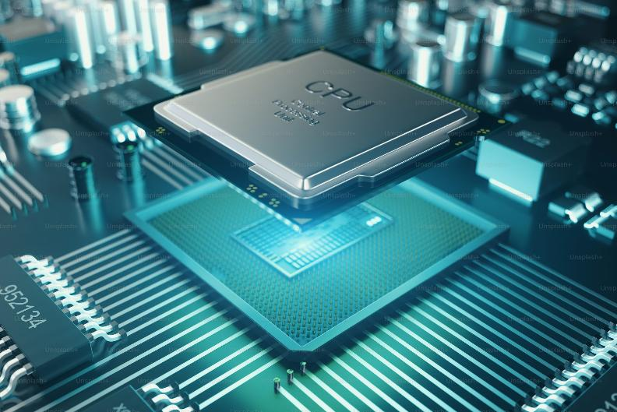
CPU
4004 a four-bit processor,
limited to just 2⁴ (16)
distinct combinations (“words.”)
To distinguish the 26 letters of the alphabet & up to six
punctuation symbols, the computer had to combine two
four-bit words.

Slide 46
CPU
Potential of microprocessors
realised when Intel
introduced an eight-bit
processor, the 8008, in
1972.
Subsequent development of 16-bit, 32-bit and 64-bit
processors increased capacity to handle data &
increased operating speed.

Slide 47
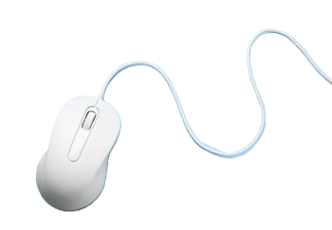
The Mouse
Douglas Engelbart 1963-64
Need for a better way to point
& click on a screen display
By 1968 able to divide screen
into multiple windows each
able to display text or an
image
Notes:
Until this time the keyboard provided the means of interaction
with this infantile computer.
Engelbart an American engineer & pioneer in many aspects of computer science introduced the mouse providing a way of pointing to & clicking to control pathways on a screen display.
Initially one button – developed three buttons with individual
microswitches

Slide 48
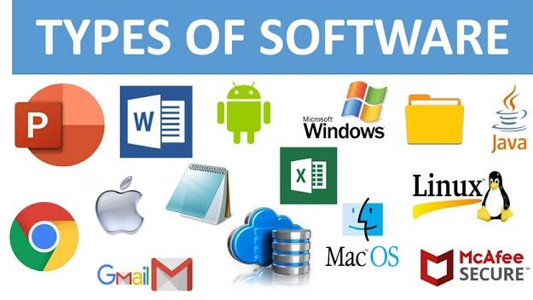
Software
Programmes in HLL for use by the computer
- business software General Ledger programme
- word processor – Electric pencil
1979 - financial analysis software VisiCalc
Paul Allen & Bill Gates - used
BASIC & created O/S
programming language for
most computer manufacturers
Microsoft
Notes:
Meeting at high school, Allen and Gates were friends &
enthusiastic computer programmers.
Microsoft was formed and when IBM entered the
microcomputer business in 1980 formed a partnership
which would lead to the development of the largest software
company in the world. Allen the innovator & Gates predominantly
the marketer

Slide 49
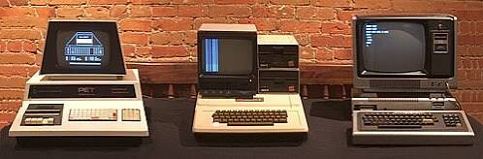
Hardware
1980s
Commodore PET Apple II TRS -80
Also - Amstrad, Tandy, Sinclair ZX 80, Altair, Acorn
Notes:
It is perhaps of interest to look at development of the Apple computer company.
Steve Wozniak working as an intern at Hewlett-Packard designed a computer which the company failed to recognise as a potential product.
Wozniak shared his knowledge with Steve Jobs a fellow Homebrew Computer Club member and they decided to build and market this computer.
Wozniak the designer and Jobs the marketer – Playboy advertising

Slide 50



Hardware
2020s
Laptop computer
Desktop computer
Tablet
Notes:
During the next 40 years there has been steady development of
the various components of the computer as it currently exists.
That really completes the development of our present computer.

Slide 51

Networking
Internal - Office / building
External - Everywhere
Ethernet
Robert Metcalf 1973
Connection digital computers
& printers in office
Able to transmit and receive
3 million bits/second
Notes:
Having created our computer and the instructions on how to
make it work there was the need to link separate computers
to permit the more rapid sharing of information.
Two major networks evolved

Slide 52
Networking
External/widely
1969 ARPANET – government and academic-research labs
1981 CSNET (Computer Science Network)
1991 World Wide Web (www.) - Tim Berners-Lee et al at CERN
– protocol based on hypertext (a computer code within a document) to make information transfer easier
New applications - Browsers – Netscape,
Numerous since - MSN, Google, Firefox
Notes:
Linkage of computers beyond the office or laboratory required
links through the extensive telecommunications wiring
networks then available.
ARPANET access restricted by authorisation and cost.
CSNET enabled wide linkages
Tim Berners-Lee of England and others at CERN (European
Organization for Nuclear Research)

Slide 53

Networking – Wireless
Uses radio waves to provide high-
speed internet & local network
access to devices within range of
a router or access point.
Development began 1990s with foundational radio wave technologies, including crucial work by Australia's CSIRO
Progressive development with increasing band width &
speed of transmission
Notes:
Linkage initially by wire but increasingly from 1990 by Wireless – most effective when devices within line of sight of each other

Slide 54

Networking
- multiple connections
Notes:
In this way we have created extensive and readily accessible worldwide linkages of our devices.
Linkage initially by wire but increasingly from 1990 by Wireless - uses radio waves to provide high-speed internet and local network access to devices within range of a router or access point.

Slide 55


Handheld digital devices
1990 - Personal Digital Assistant
(PDA)
Liquid crystal display, miniature
keyboard or stylus to allow
direct writing
Palm Pilot, Blackberry PDA
iPod – storing 1,000 songs, notes & appointments
Notes:
The Pilot enabled data sharing with a PC & made it possible to
organize & carry information
Included an electronic calendar, telephone number & address
list, memo pad, & expense-tracking software.
The BlackBerry PDA, introduced in 2002, became a favourite in
the corporate world because of features that allowed
employees to make secure connections with their company’s
databases

Slide 56

Handheld digital devices
Mobile phones
Smart phones with touch-screen
interface
Keyboard & voice data input
Access to many applications
(Apps) assisting daily activity
Ready interchange of documents
& other media between phone
& other devices via Internet
Notes:
At conclusion ask everyone to pull out their smartphone

Slide 57

Your Mobile Phone
>25 million times more powerful
than the Apollo 11 Guidance
Computer
2,000-5,000 times faster than the
1985 Cray-2, historically the
fastest supercomputer, reliant on
passive cooling.
Has enormous levels of processing
power while consuming <5 watts
power & resting comfortably in
your hand.
Notes:
Over 25 million times more powerful than the Apollo 11
Guidance Computer that successfully put humans on the
moon in 1969.
2,000-5,000 times faster than the 1985 Cray-2, historically the
fastest supercomputer & relies on passive cooling.
The Cray-2 weighed 2.5 tons, required specialized liquid
coolant, and cost upwards of $16 million.

Slide 58

Artificial Intelligence (AI)
Describes the ability of a
computer or computer-
controlled robot to perform
tasks commonly associated
with intelligent beings.
AI frequently applied to
computing programmes with some of the intellectual
processes characteristic of humans - the ability to
reason, discover meaning, generalize, or learn from
past experience.
AI - machine instruction / learning
Notes:
I have attempted to pull together some definitions of Artificial Intelligence

Slide 59

Artificial Intelligence (AI)
Hearing
Our brain continually
computes based
upon memory of
past experience &
current input
Vision
Past Experience
Touch
Smell
Taste
Proprioception
Despite continuing advances in computer processing speed & memory capacity, there are no programmes that can match human flexibility over wider domains or in tasks requiring much everyday knowledge.
Notes:
Our brain is continually receiving input via our senses of -

Slide 60
Artificial Intelligence (AI)
Some programmes have attained/exceeded the performance levels of human experts & professionals in executing certain specific tasks.
Artificial intelligence in this limited sense is found in applications such as –
search engines
voice, handwriting, facial & object recognition
health care
vaccine & drug development
data sifting – Govt departments & legal practices
Notes:
Not new!
Note the creation of a chess-playing programme more than 25
years ago able to defeat world Champion Garry Kasparov

Slide 61




Artificial Intelligence (AI)
Shoplifter
identification
Facial
recognition
Tumour cell
identification
Accuracy of
diagnosis
Smart plus vast
memory capacity
Number plate
recognition
Stolen vehicle
identification
Tasks requiring everyday knowledge
or
Human flexibility over multiple domains
BUT
=
Notes:
Facial recognition – Border security, shoplifter identity
Health care – pathology, radiology
Number plate recognition – stolen vehicles, failure registration
AI can out–perform us in the completion of many specific
everyday tasks

Slide 62




Artificial Intelligence (AI)
A very significant human creation
alongside -
The wheel
The steam engine
The internal combustion engine
Vaccination

Slide 63


Artificial Intelligence (AI)
* But like the gun or atomic energy carries the
risk of harm in careless or malevolent hands

Slide 64



So what is Artificial Intelligence (AI) ?
Mostly the term is used in a generic sense and includes any computer-controlled automated process.
Eg. supermarket checkout
robotic automobile assembly
conversion speech to text

Slide 65



Artificial Intelligence (AI)
Broadly used includes information sorting and retrieval programmes
Identity - facial recognition
Medical diagnosis
Research

Slide 66
Artificial Intelligence (AI)
A more specific definition –
Artificial intelligence (AI) might best be described as the ability of computer systems & machines to perform tasks that typically require human intelligence, such as learning, reasoning, problem-solving, & decision-making.
Notes:
A more specific definition

Slide 67
Artificial Intelligence (AI)
Core Characteristics
* Simulation of Cognition: Machines mimic human mental processes like perception, language comprehension & creativity.
* Data-Driven Learning: Programmes analyse large datasets to identify patterns, adapt to new inputs, & improve over time without needing explicit hardcoded rules for every scenario.
* Autonomous Problem-Solving: Programs reach predefined goals or make recommendations independently under varying conditions.
Notes:
This last characteristic is one which is creating anxiety and provoking urgent wider consideration in how it should be managed.
However, I leave the final word to Michael Wooldridge an Oxford AI researcher.

Slide 68
Artificial Intelligence (AI)
Last word
Oxford AI researcher Michael Wooldridge
“For the foreseeable future, it is a safe bet that far more people will die from natural stupidity than from artificial intelligence”
Notes:
Aware of the considerable anxiety some aspects of Artificial
Intelligence have created, I will close with words of Oxford AI
researcher Michael Wooldridge.

